Slide 1
Ensemble Classifier Dating Plotly Dashboard
Gary Garth Simmons
15 October 2023
NYCDSA Capstone

Slide 2

Dating is hard
Relationships by themselves are hard to maintain
Getting a date for some is even harder
Dating Apps
Blind Dating
Photo 207149960 © Prostockstudio | Dreamstime.com

Slide 3
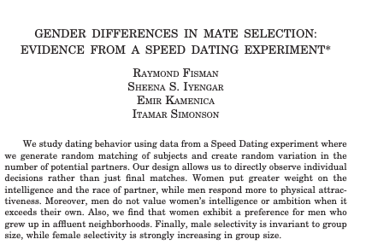
Blind Dating Experiment 2006
20 waves of blind dating experiment at Colombia http://www.stat.columbia.edu/~gelman/stuff_for_blog/sheena.pdf
Women favor Intelligence, race, and affluent neighborhoods
Men favor Attractiveness
Men dislike partners with more ambition or intelligence
But what about other factors?

Slide 4
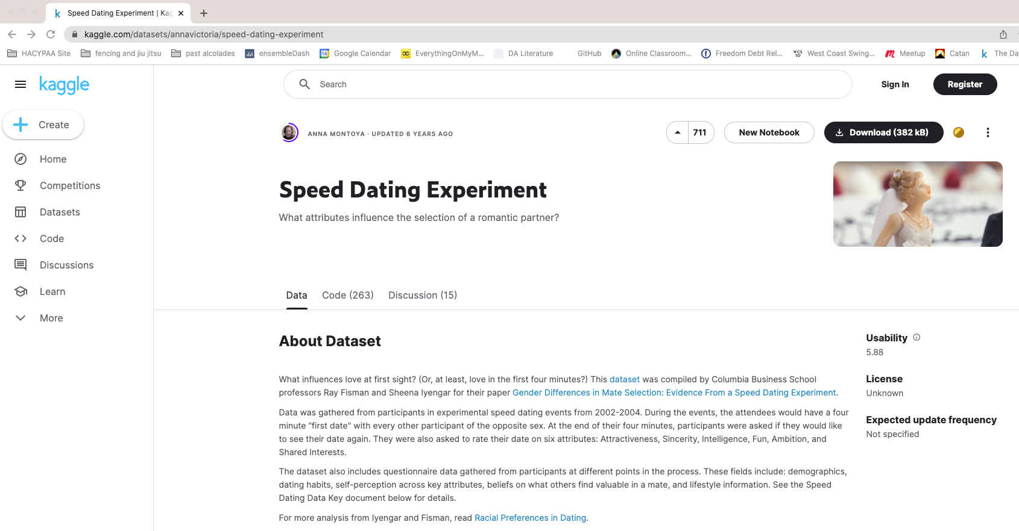
https://www.kaggle.com/datasets/annavictoria/speed-dating-experiment

Slide 5
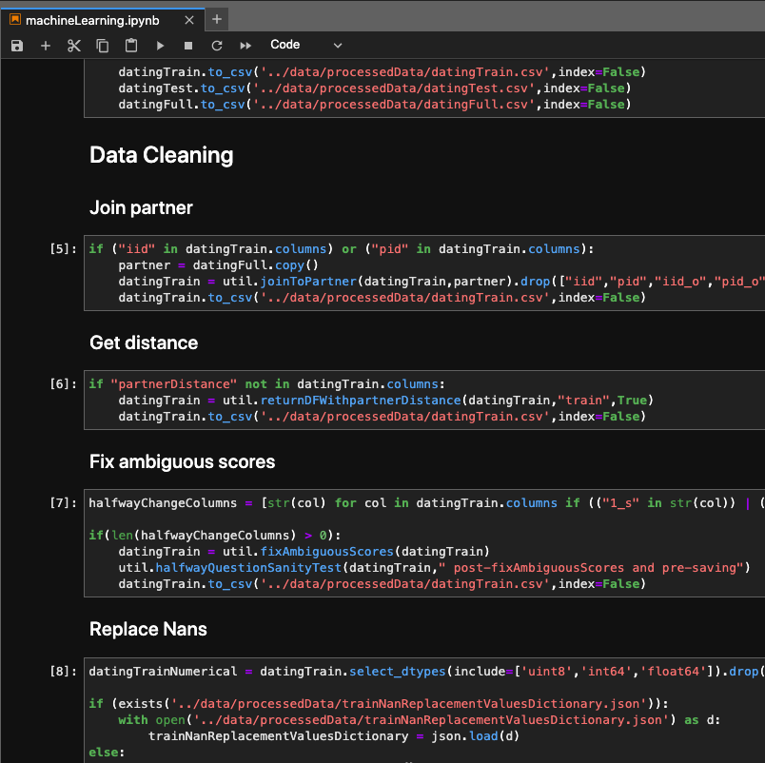
Data Cleaning
Add locations via Nominatim
Transform zipcodes to propper zipcodes
Turn categorical data into strings
Turn stringed numbers into numbers
Create dummies for string sets under 30
Train-test-split
Join to partner
Get distances
Fix Ambiguous Scores
Attr, Sinc, Int, Fun,Amb, Shar
3 Questions needed scaling (What you look for and what do others look for)
2 Halfway questions (What you look for and self-rating)
Replaces nans with modes and means

Slide 6
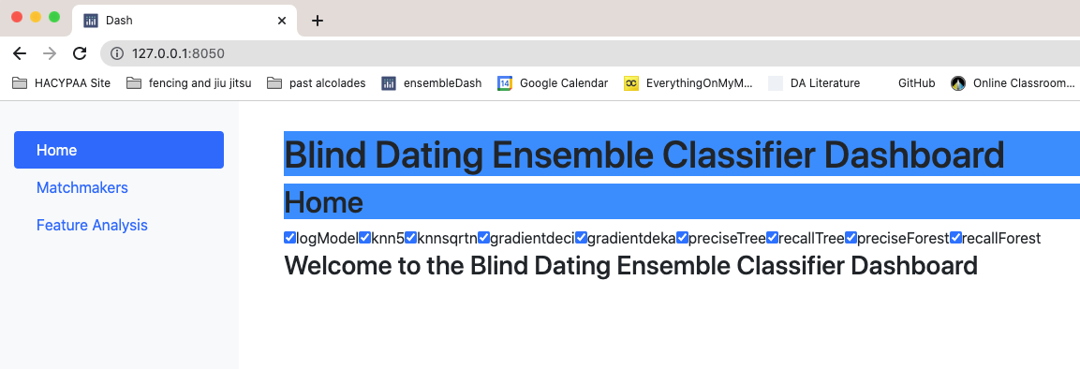
Let’s proceed to the app

Slide 7
Conclusions
Dating within the same race does have a significant correlation, but it is a small R value of 0.03. It helps, but not really
The correlation between candidate and partner answers to “How many matches do you estimate you will get” is positive. Confidence is key.
There is a significant positive correlation for getting matched if candidate or partner goes out several times a week or left the go out question blank, but these correlations are small as 0.1.

Slide 8
Next Steps
Deployment
Possible Next Steps:
Add models and metric scorings
Optimize Performance and Data Storage
Other Applications
Match making
Adding more parameters avoiding the sandbox

Slide 9
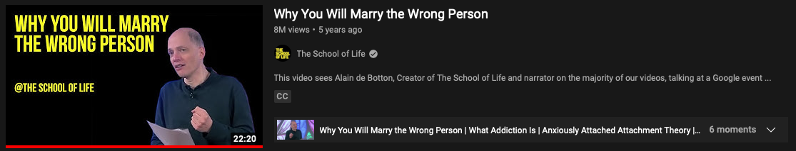
The importance of relationships
Life is hard
Relationships are hard romantically and and non-romantically
Communicating, learning, and teaching are important in relationships
Relationships help us grow as individuals and as a society
Let’s learn from each other
https://www.youtube.com/watch?v=-EvvPZFdjyk

Slide 10
Sources
Featured Image: Photo 207149960 © Prostockstudio | Dreamstime.com
Research Paper: http://www.stat.columbia.edu/~gelman/stuff_for_blog/sheena.pdf
Kaggle: https://www.kaggle.com/datasets/annavictoria/speed-dating-experiment
Youtube Video: https://www.youtube.com/watch?v=-EvvPZFdjyk

